Slide 1
Fundamentals of Artificial Intelligence
GROUP 3
Members:
Cáceres Díaz, Renzo (11200004)
Escobar Villa, Andrés (6200075)
Gonzales Aburto, Ricardo (18200061)
Huamaní Avendaño, Dulce (18200219)
Molina Yupanqui, Flor (18200164)
Palomino Loa, Junior (18200172)
Quispe Vega, Anthony (18200179)
Vera León, Bryan (18200124)

Slide 2
Table of Contents
1
3
2
4
Applications in industry and services
Artificial intelligence
Definition, types
Examples, advantages and disadvantages
Intelligent Machine
Test de Turing

Slide 3
1
Artificial intelligence
Definition, types

Slide 4

Artificial intelligence
Although experts do not agree to give a unified definition of what Artificial Intelligence is, we can find very valid approaches.
Thus, the European Commission defines AI as those systems that manifest intelligent behavior, being able to analyze the environment and perform actions, with a certain degree of autonomy, in order to achieve specific objectives.

Slide 5
Types of Artificial Intelligence
1
2
3
4
Reactive machines
Limited memory
Theory of mind
Awareness
They are the most basic type of Intelligence.
They are able to look to the past, but in a limited and temporary way
They are able to learn based on our behaviors and deduce and know what our tastes are.
Has developed self-awareness and is able to recognize itself as an independent entity

Slide 6
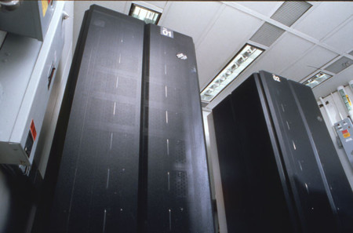
Reactive machines
Reactive machines are the most basic type of Artificial Intelligence; they are based on decisions about the present, that is, they have no memory and therefore cannot look to the past to learn from past experiences and are unable to evolve.
E.g.: Deep Blue

Slide 7
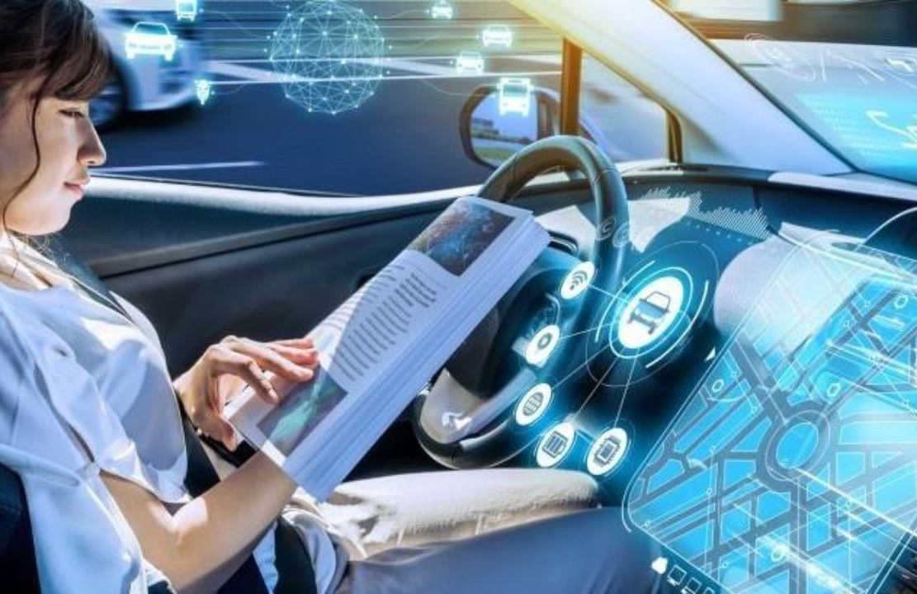
Limited memory
Memory-constrained AI machines are capable of looking to the past, but in a limited and temporary way. In addition, they can store the information they collect for a certain time and add it to their programming to create new patterns of behavior and response for the not distant future. That is, they are not able to make complete and enduring representations over time.
E.g.: Autonomous cars

Slide 8
Theory of mind
The theory of mind presents systems or machines whose AI allows them to understand how their environment works, that is, the people, objects and other systems that surround them. They are systems capable of learning based on our behaviors and deduce and know what our tastes, needs, desires or even how we expect to be treated are.

Slide 9
Awareness
We have reached what is still the realm of science fiction, because there is currently no self-awareness of AI. It would be an Artificial Intelligence that has developed self-awareness and is able to recognize itself as an independent entity, which can make its own decisions, differentiating between it and the objects, people and systems that surround it. It would be the first step in what he has called the uniqueness of technology.

Slide 10
2
Intelligent machine

Slide 11
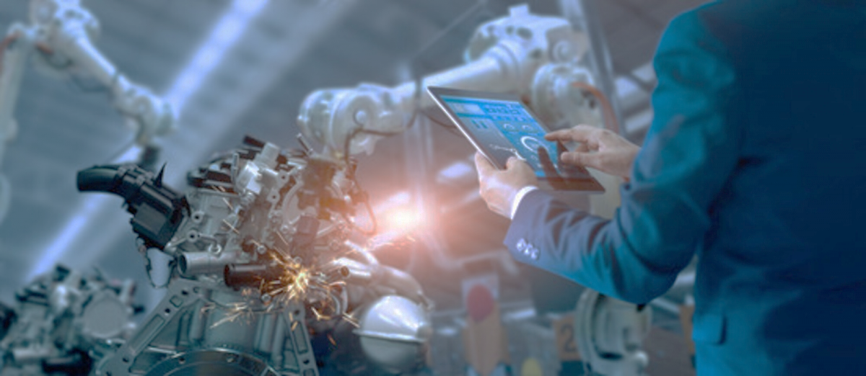
Intelligent Machines
An intelligent machine is a type of device that integrates both machine-to-machine (M2M) technology and cognitive computing, artificial intelligence, or machine learning, for example. This allows you to solve problems, or even make decisions that translate into concrete action. That is, the closest thing to human reasoning capacity, with clear implications for business and society in general.

Slide 12
3
Applications in industry and services
Examples, advantages and disadvantages

Slide 13


Applications
Human resources
Customer Support
Human resources departments can also use Virtual Intelligence systems to carry out the processes of selection and recruitment of workers or carry out other tasks related to the analysis and management of company data, so that AI groups this data and provides different results regarding different areas, such as the evolution of talent, productivity or conflicts.
They can analyze the behavior of users and be able to offer them the help they are looking for practically in real time. Customer service generates a large amount of data that AI systems can help analyze to create predictive services with which companies can anticipate the queries and needs of their customers, offering them a more personalized attention.

Slide 14

Applications
Marketing & Sales
In an increasingly competitive market, where it is necessary to offer products or services with added value in order to differentiate itself from the competition, data analysis and consumer profiling are key and this is where Artificial Intelligence applied to marketing and sales comes in, since it allows automating processes such as mining and analysis of the extracted information.
AI applied to marketing allows predicting future needs through the use of tools capable of analyzing conducts and elaborating patterns of behavior based on the footprint that users leave on the Internet. Thus, they can create user profiles, segment the audience and thus be able to offer them products according to their needs and desires.

Slide 15
Advantages and disadvantages
Advantages
Disadvantages
It increases the efficiency of processes and carries them out faster. It allows to automate repetitive processes. Being based on computational procedures, it does not make human errors. He is tireless, he can work every day at all hours. It can analyze huge amounts of data, extracting relevant information and creating profiles or predictive models in many areas. You can make people's day-to-day lives easier with tools like virtual assistants.
The more sophisticated and complex ARTIFICIAL Intelligence systems become, the more likely they are to replace human workers, negatively impacting the labor market. Since they still lack creativity and improvisational skills, their solutions and responses are based on algorithms and analysis of pre-existing information, limiting their ability to make decisions beyond data. It can be used for illegal purposes, such as the creation and distribution of malware or phishing.

Slide 16
4
Turing Test

Slide 17
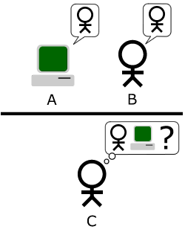
Turing Test
The Turing test is an examination of a machine's ability to exhibit intelligent behavior similar to that of a human being or indistinguishable from it. Alan Turing proposed that a human evaluate natural language conversations between a human and a machine designed to generate responses similar to those of a human. The evaluator would know that one of the participants in the conversation is a machine and the participants would be separated from each other.
If the evaluator cannot distinguish between human and machine correctly (Turing originally suggested that the machine should convince an evaluator, after 5 minutes of conversation, 70% of the time), the machine would have passed the test.

